Slide 1
Fundamentals of Programming
Elementary Programming

Slide 2
Data Types
Data Type | Memory | Range
int (integer numbers) | 4 Bytes | -2147483648 to 2147284647
short (integer numbers) | 2 Bytes | -32768 to 32767
char ( Character ) | 1 Byte | -128 to 127
float (real numbers) | 4 Bytes | 3.4x10⁻³⁸ to 3.4x10³⁸
double (real numbers) | 8 Bytes | 1.7 x10⁻³⁰⁸ to 1.7x10³⁰⁸
unsigned short (+ve numbers) | 2 Bytes | 0 to 65535
unsigned int (+ve numbers) | 4 Bytes | 0 to 4294967295

Slide 3
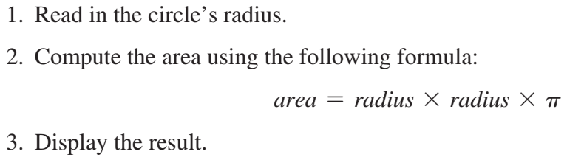
Writing a Simple Program
Involves designing strategy/ algorithms and translating them into programming instructions, or code
Algorithm: describes how a problem is solved by listing the actions that must be taken and the order of their execution
Problem:Write a simple program to compute area of a circle

Slide 4
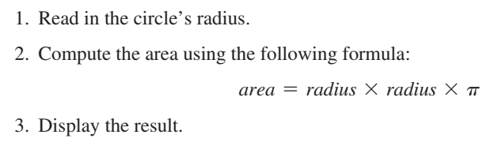
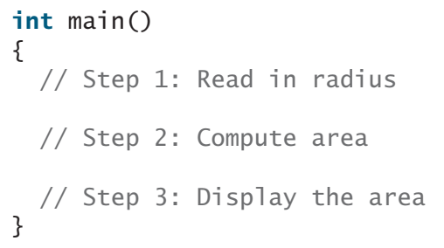
Writing a Simple Program
The above breakdown of the problem can be translated to a program as

Slide 5
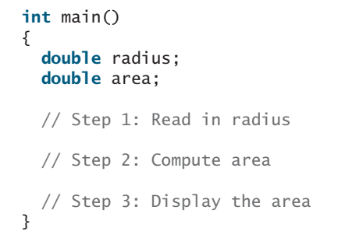
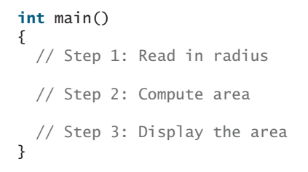
Writing a Simple Program
The program needs to read the radius entered by the user from the keyboard. This raises two important issues:
1) Reading the radius 2) Storing the radius in the program
In order to store radius and area, the program needs a variable. A variable represents a value stored in the computer’s memory.
double is a data type: we declared two variables radius and area

Slide 6
Writing a Simple Program
Rather than using x and y as variable names, choose descriptive names: in this case, radius for radius, and area for area. To let the compiler know what radius and area are, specify their data types. That is the kind of the data stored in a variable, whether integer, floating-point number, or something else. This is known as declaring variables. C++ provides simple data types for representing integers, floating-point numbers (i.e., numbers with a decimal point), characters, and Boolean types. These types are known as primitive data types or fundamental types.
Next step is to prompt the user for entering value of radius
Use cout to show the message
Use cin to read entered value from the keyboard

Slide 7
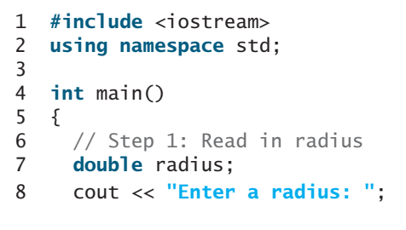
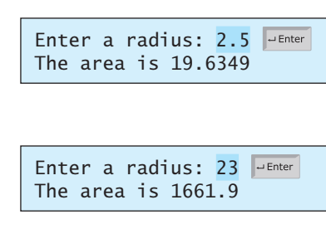
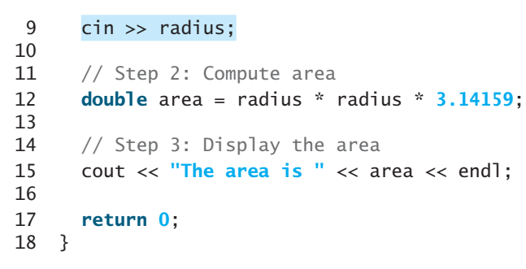
Reading Input from the Keyboard
Input from the keyboard is read by cin and stored in variable

Slide 8
Reading Input from the Keyboard
cin (pronounced see-in) stands for console input. The >> symbol, referred to as the stream extraction operator, assigns an input to a variable. As shown in the sample run, the program displays the prompting message "Enter a radius: "; the user then enters number 2, which is assigned to variable radius. The cin object causes a program to wait until data is entered at the keyboard and the Enter key is pressed. C++ automatically converts the data read from the keyboard to the data type of the variable.

Slide 9
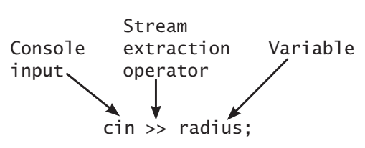

Reading Input from the Keyboard
The >> operator is the opposite of the << operator. The >> indicates that the data flows from cin to a variable. The << shows that the data flows from a variable or a string to cout. You can think of the stream extraction operator >> as an arrow that points to the variable and the stream insertion operator << as an arrow that points to the cout, as shown here:

Slide 10
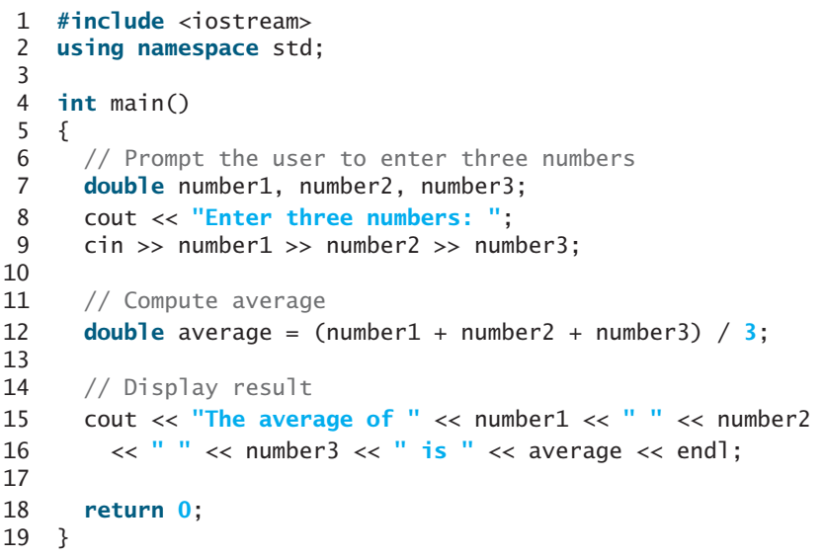
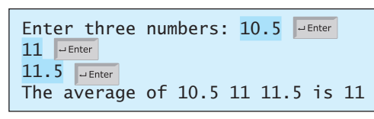
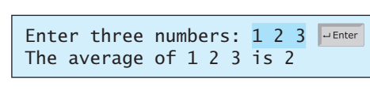
Reading Input from the Keyboard
single cin statement can
read multiple inputs
You may enter three numbers separated by spaces, then press the Enter key,
or enter each number followed by the Enter key

Slide 11
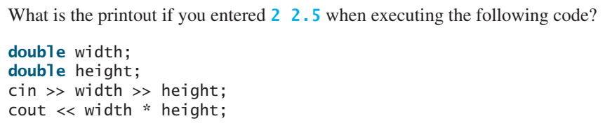
Reading Input from the Keyboard
Most of the programs in the early weeks of the course perform three steps: input, process, and output, called IPO. Input is receiving input from the user; process is producing results using the input; and output is displaying the results.

Slide 12
Identifiers
Identifiers are the names that identify elements such as variables and functions in a program
An identifier is a sequence of characters comprising letters, digits, and underscores (_).
An identifier must start with a letter or an underscore; it cannot start with a digit.
An identifier cannot be a reserved word. (See Appendix A, “C++ Keywords,” for a list of reserved words.)
An identifier can be of any length, but your C++ compiler may impose restriction.
Use identifiers of 31 characters or fewer to ensure portability

Slide 13
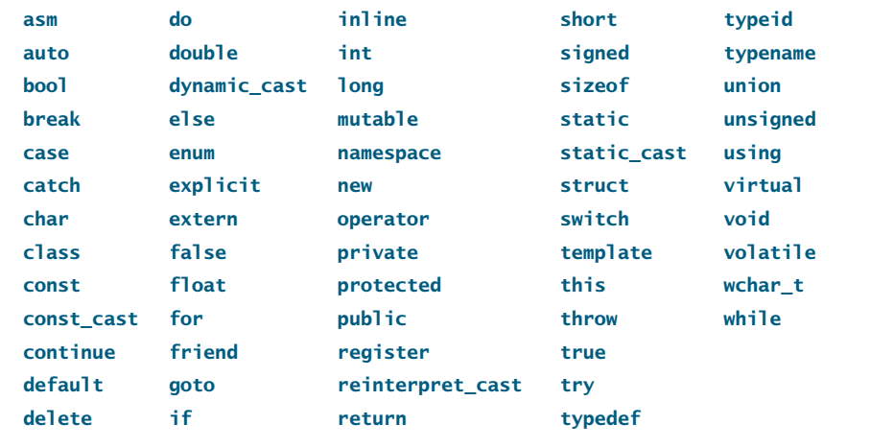
Identifiers
C++ Keywords

Slide 14

Identifiers
Since C++ is case-sensitive, area, Area, and AREA are all different identifiers.
Identifiers are used to name variables, functions, and other things in a program. Descriptive identifiers make programs easy to read. Avoid using abbreviations for identifiers using complete words is more descriptive. For example, numberOfStudents is better than numStuds, numOfStuds, or numOfStudents.
Valid Identifiers???

Slide 15
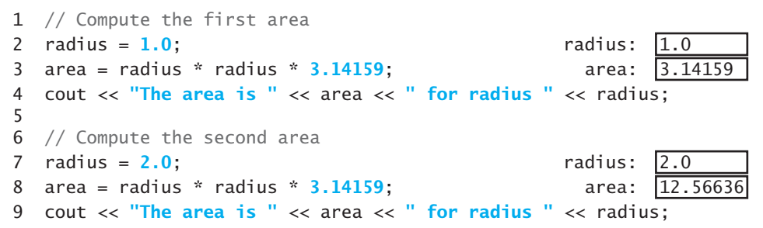
Variables
Variables are used to represent values that may be changed in the program

Slide 16

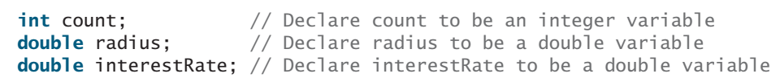
Variables
Variables are used to represent data of a certain type.
To use a variable, you declare it by telling the compiler its name as well as the type of data it can store.
The variable declaration tells the compiler to allocate appropriate memory space for the variable based on its data type.
The syntax for declaring a variable is

Slide 17
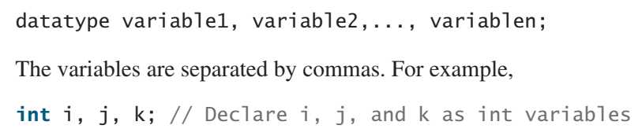
Variables
If variables are of the same type, they can be declared together, as follows:
We say “declare a variable,” but not “define a variable.” We are making a subtle distinction here. A definition defines what the defined item is, but a declaration usually involves allocating memory to store data for the declared item.

Slide 18


Variables
Variables often have initial values. You can declare a variable and initialize it in one step.
A variable must be declared before it can be assigned a value. A variable declared in a function must be assigned a value. Otherwise, the variable is called uninitialized and its value is unpredictable often called garbage value. Whenever possible, declare a variable and assign its initial value in one step. This will make the program easy to read and will avoid programming errors.
variable must be declared & initialized before it can be used.
← Both are Equivalent →

Slide 19
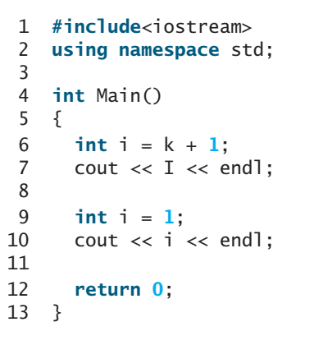
Variables
Identify and fix the errors in the following code

Slide 20

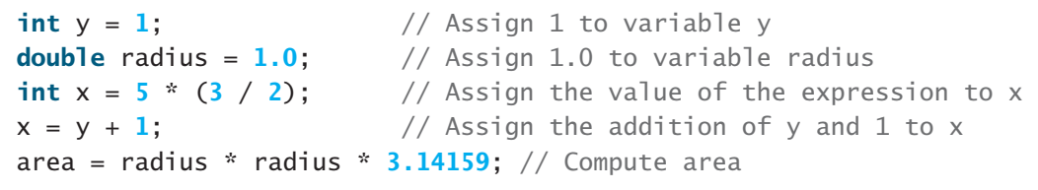
Assignment Statements and Assignment Expressions
An assignment statement designates a value for a variable. An assignment statement can be used as an expression
An expression represents a computation involving values, variables, and operators that, taking them together, evaluates to a value

Slide 21


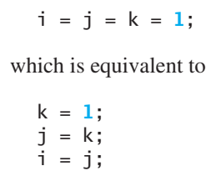
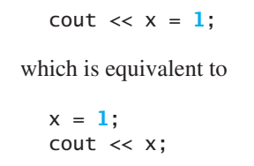
Assignment Statements and Assignment Expressions
In mathematics, x = 2 * x + 1 denotes an equation. However, in C++, x = 2 * x + 1 is an assignment statement that evaluates the expression 2 * x + 1 and assigns the result to the variable x.
In C++, an assignment statement is essentially an expression that evaluates to the value to be assigned to the variable on the left side of the assignment operator. For this reason, an assignment statement is also known as an assignment expression.

Slide 22
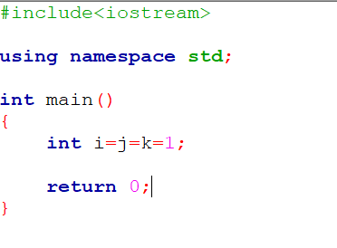

Assignment Statements and Assignment Expressions
Identify and fix the errors in the following code

Slide 23

Named Constants
A named constant is an identifier that represents a permanent value.
The value of a variable may change during the execution of a program, but a named constant, or simply constant, represents permanent data that never changes.
In example of circle area, value of Pi is a constant. If you use it frequently, you don’t want to keep typing 3.14159; instead, you can declare a constant for Pi

Slide 24
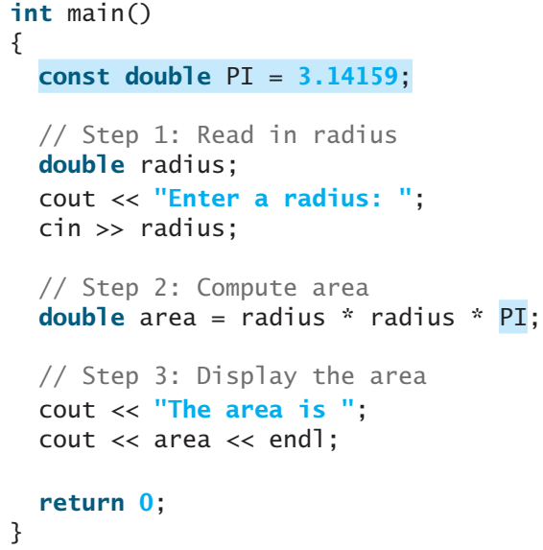
Named Constants

Slide 25
Named Constants
By convention, constants are named in uppercase: PI, not pi, Pi or _Pi
There are three benefits of using constants:
you don’t have to repeatedly type the same value;
if you have to change the constant value (e.g., from 3.14 to 3.14159 for PI), you need change it only in a single location in the source code;
descriptive constant names make the program easy to read.

Slide 26
Numeric Data Types and Operations
C++ has nine numeric types for integers and floating-point numbers with operators +, -, *, /, and %
Every data type has a range of values. The compiler allocates memory space for each variable or constant according to its data type. C++ provides primitive data types for numeric values, characters, and Boolean values

Slide 27
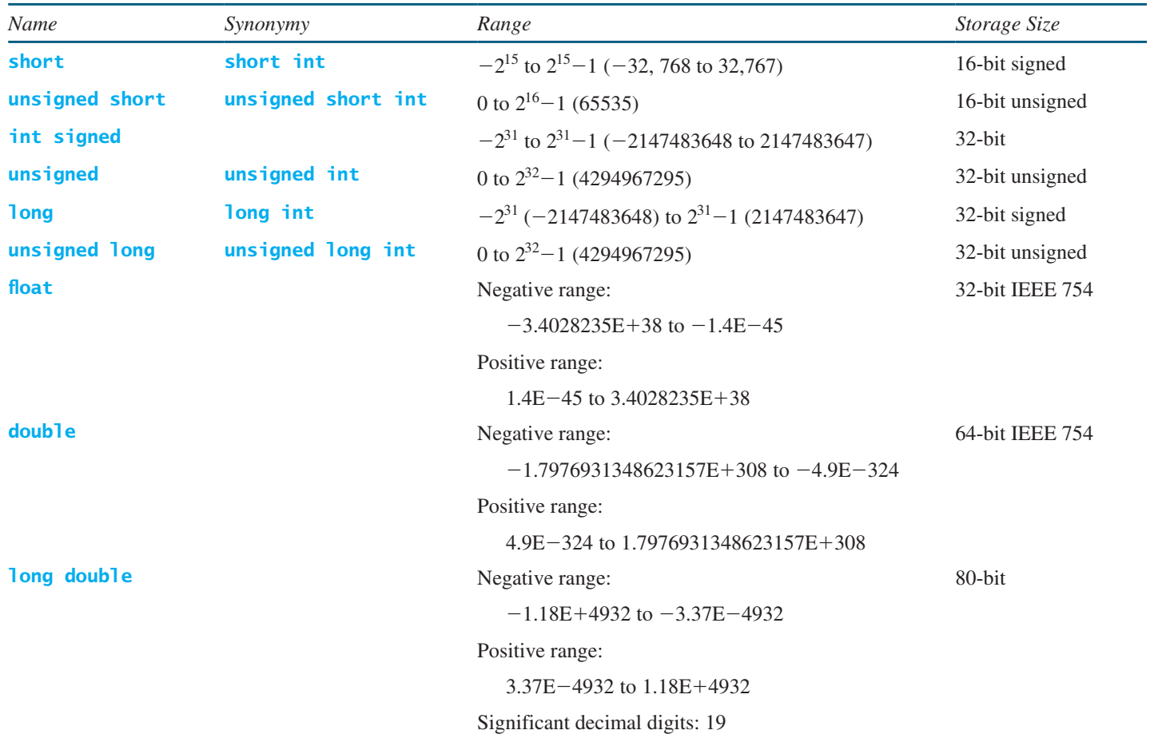
Numeric Data Types and Operations

Slide 28
Numeric Data Types and Operations
C++ uses three types for integers: short, int, and long. Each integer type comes in two flavors: signed and unsigned. Half of the numbers represented by a signed int are negative and the other half are non-negative. All the numbers represented by an unsigned int are nonnegative. Because you have the same storage size for both, the largest number you can store in an unsigned int is twice as big as the largest positive number you can store in a signed int. If you know the value stored in a variable is always nonnegative, declare it as unsigned.
short int is synonymous with short. unsigned short int is synonymous with unsigned short. unsigned is synonymous with unsigned int. long int is synonymous with long. unsigned long int is synonymous with unsigned long

Slide 29
Numeric Data Types and Operations
C++ uses three types for floating-point numbers: float, double, and long double. The double type is usually twice as big as float. So, the double is known as double precision, while float is single precision. The long double is even bigger than double. For most applications, using the double type is desirable.
For convenience, C++ defines constants INT_MIN, INT_MAX, LONG_MIN, LONG_MAX, FLT_MIN, FLT_MAX, DBL_MIN, and DBL_MAX in the <limits> header file

Slide 30
Numeric Data Types and Operations
The size of the data types may vary depending on the compiler and computer you are using. Typically, int and long have the same size. On some systems, long requires 8 bytes. You can use the sizeof function to find the size of a type or a variable on your machine.

Slide 31


Numeric Data Types and Operations
Numeric Literals
A literal is a constant value that appears directly in a program. In the following statements, for example, 34 and 0.305 are literals
By default, an integer literal is a decimal integer number. To denote an octal integer literal, use a leading 0 (zero), and to denote a hexadecimal integer literal, use a leading 0x or 0X (zero x). For example, the following code displays the decimal value 65535 for hexadecimal number FFFF and decimal value 8 for octal number 10.

Slide 32
Numeric Data Types and Operations
Floating-point literals can be written in scientific notation in the form of a * 10^{b}. For example, the scientific notation for 123.456 is 1.23456 * 10² and for 0.0123456 it’s 1.23456 * 10⁻². A special syntax is used to write scientific notation numbers. For example, 1.23456 * 10² is written as 1.23456E2 or 1.23456E+2 and 1.23456 * 10⁻² as 1.23456E-2. E (or e) represents an exponent and can be in either lowercase or uppercase.
The float and double types are used to represent numbers with a decimal point. Why are they called floating-point numbers? These numbers are stored in scientific notation internally. When a number such as 50.534 is converted into scientific notation, such as 5.0534E+1, its decimal point is moved (i.e., floated) to a new position.

Slide 33
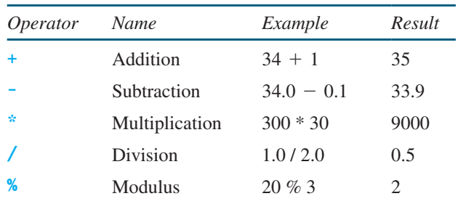
Numeric Data Types and Operations
Numeric Operators
The operators for numeric data types include the standard arithmetic operators: addition (+), subtraction (–), multiplication (*), division (/), and remainder (%)
The operands are the values operated by an operator

Slide 34
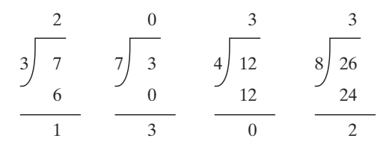
Numeric Data Types and Operations
When both operands of a division are integers, the result of the division is the quotient and the fractional part is truncated. For example, 5 / 2 yields 2, not 2.5, and –5 / 2 yields -2, not –2.5. To perform regular mathematical division, one of the operands must be a floating point number. For example, 5.0 / 2 yields 2.5
The % operator, known as modulo or remainder operator, works only with integer operands and yields the remainder after division.

Slide 35
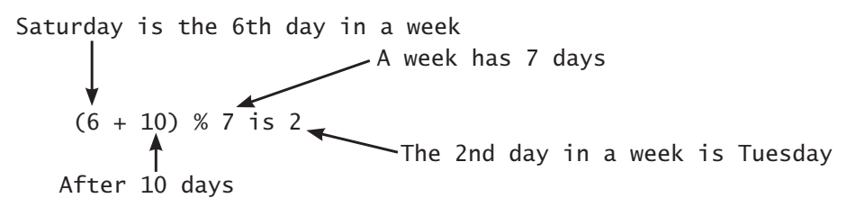
Numeric Data Types and Operations
Suppose you and your friends are going to meet in 10 days. What day is in 10 days? You can find that day is Tuesday using the following expression:

Slide 36
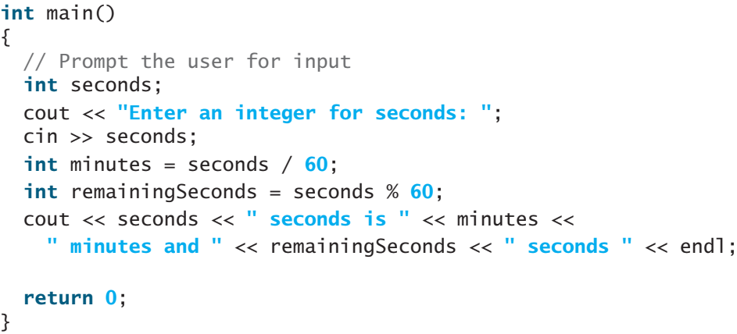

Numeric Data Types and Operations
Following program obtains minutes and remaining seconds from an amount of time in seconds. For example, 500 seconds contains 8 minutes and 20 seconds .

Slide 37


Numeric Data Types and Operations
The pow(a, b) function can be used to compute a^{b}. pow is a function defined in the cmath library. The function is invoked using the syntax pow(a, b) (i.e., pow(2.0, 3)) that returns the result of a^{b} (2³). Here, a and b are parameters for the pow function and numbers 2.0 and 3 are actual values used to invoke the function.
Google cmath to find other math functions

Slide 38
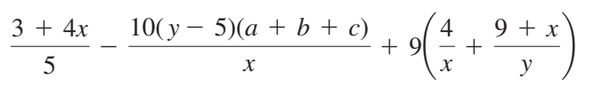

Evaluating Expressions and Operator Precedence
C++ expressions are evaluated in the same way as arithmetic expressions

Slide 39
Evaluating Expressions and Operator Precedence
Operators contained within pairs of parentheses are evaluated first. Parentheses can be nested, in which case the expression in the inner parentheses is evaluated first. When more than one operator is used in an expression the following operator precedence rule is used to determine the order of evaluation.
Multiplication, division, and remainder operators are applied next. If an expression contains several multiplication, division, and remainder operators, they are applied from left to right.
Addition and subtraction operators are applied last. If an expression contains several addition and subtraction operators, they are applied from left to right.

Slide 40
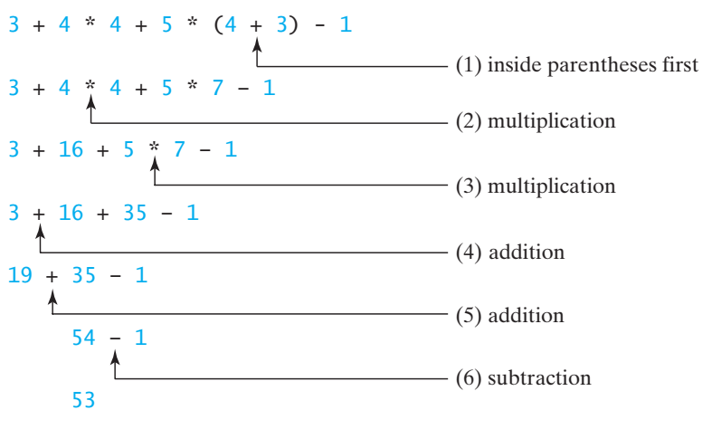
Evaluating Expressions and Operator Precedence

Slide 41


Augmented Assignment Operators
The operators +, -, *, /, and % can be combined with the assignment operator to form augmented operators.
Often, the current value of a variable is used, modified, and then reassigned back to the same variable. For example, the following statement increases the variable count by 1:
C++ allows you to combine assignment and addition operators using an augmented assignment operator. For example, the preceding statement can be written as follows:

Slide 42
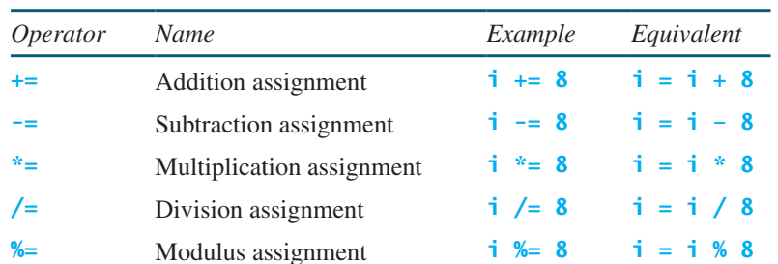
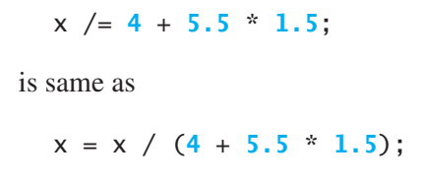
Augmented Assignment Operators
The augmented assignment operator is performed last after the other operators in the expression are evaluated

Slide 43
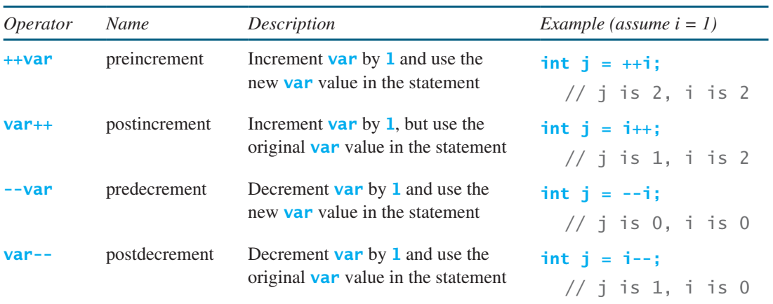
Increment and Decrement Operators
The increment (++) and decrement (--) operators are for incrementing and decrementing a variable by 1

Slide 44
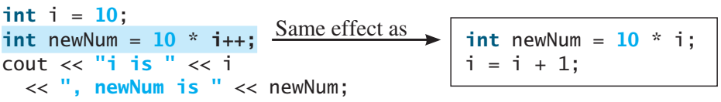
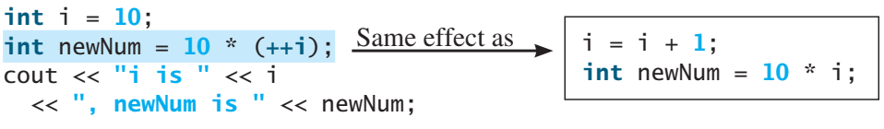
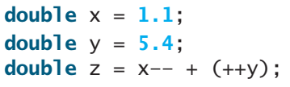
Increment and Decrement Operators
postfix i++ and prefix ++I
After following code, x becomes 0.1, y becomes 6.4, and z becomes 7.5

Slide 45
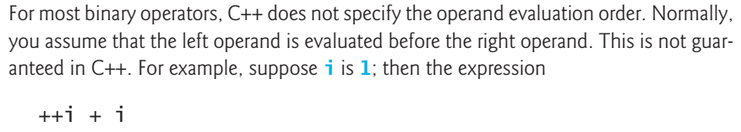
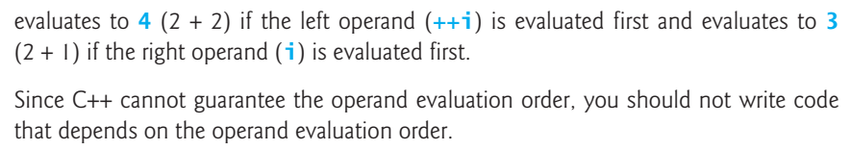
Increment and Decrement Operators

Slide 46
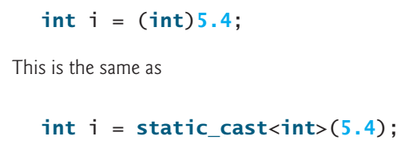
Numeric Type Conversions
If an integer and a floating-point number are involved in a binary operation, C++ automatically converts the integer to a floating-point value. So, 3 * 4.5 is the same as 3.0 * 4.5. C++ also allows you to convert a value from one type to another explicitly by using a casting operator. The syntax is static_cast<type>(value), where the value is a variable, numeric literal or expression. For example, the following statement sets variable i to 5.

Slide 47
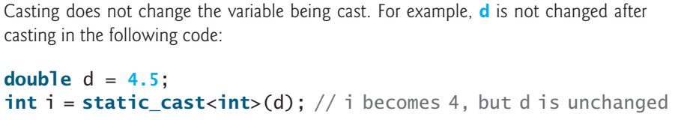
Numeric Type Conversions
Casting a variable of a type with a small range to a variable of a type with a larger range is known as widening a type. Casting a variable of a type with a large range to a variable of a type with a smaller range is known as narrowing a type. Narrowing a type, such as assigning a double value to an int variable, may cause loss of precision. Lost information might lead to inaccurate results. The compiler gives a warning when you narrow a type, unless you use static_cast to make the conversion explicit.

Slide 48
Common Errors
Undeclared/Uninitialized Variables and Unused Variables
Integer Overflow
Round-off Errors
Unintended Integer Division
Forgetting Header Files

Slide 49
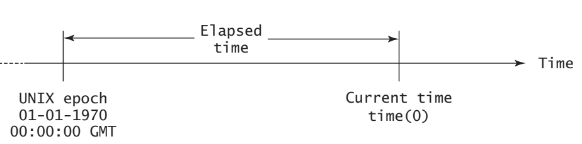
2.10 Case Study: Displaying the Current Time
You can invoke the time(0) function to return the current time.
The time(0) function, in the ctime header file, returns the current time in seconds elapsed since the time 00:00:00 on January 1, 1970 GMT.

Slide 50
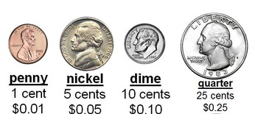
2.15 Case Study: Counting Monetary Units
The program lets the user enter an amount as a double value representing a total in dollars and cents, and outputs a report listing the monetary equivalent in the maximum number of dollars, quarters, dimes, nickels, and pennies

Slide 51
Thanks

